Slide 1

Tithing
It’s not what you think!
By Stephen M. Golden
Based on the work of Aaron Budjen
http://www.livinggodministries.net/

Slide 2
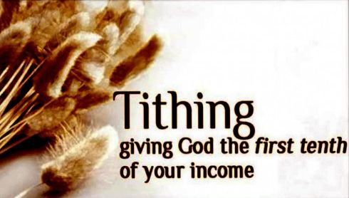
Tithing
Should Christians tithe?
Many pastors today like to encourage, or even intimidate, the members of their congregations into giving ten percent of their incomes to the Church, calling it a tithe.

Slide 3

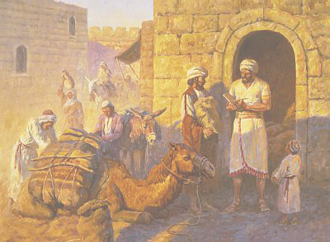
Tithing
These pastors will often read from
Malachi 3:10:
“Bring the whole tithe into the storehouse, that there may be food in my house. Test me in this,”
says the LORD Almighty, “and see if I will not throw open the floodgates of heaven and pour out so much blessing that you will not have room enough for it.”

Slide 4

Tithing
However, very few pastors have taken the time to really understand the tithe and its purpose.
For most pastors, much of what they read about the tithe doesn’t apply, or doesn’t make sense, so they ignore it.

Slide 5

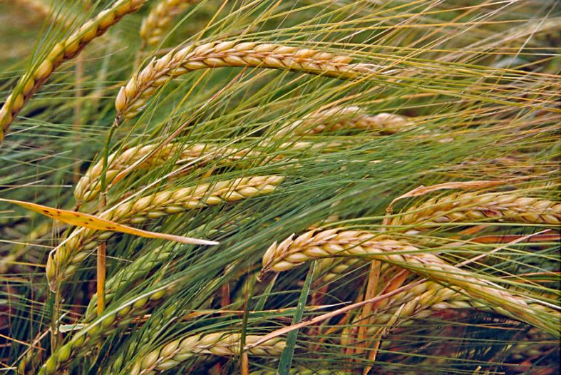
Tithing
Here’s what I mean:
Leviticus 27:30-32
“[30] ‘A tithe of everything from the land, whether grain from the soil or fruit from the trees, belongs to the LORD; it is holy to the LORD.”

Slide 6

Tithing
Here’s what I mean:
Leviticus 27:30-32
“[31] ‘If a man redeems any of his tithe, he must add a fifth of the value to it. [32] The entire tithe of the herd and flock—
every tenth animal that passes under the shepherd's rod—will be holy to the LORD.”

Slide 7
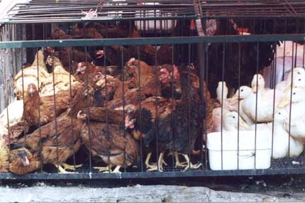
Tithing
Here’s what I mean:
These verses are talking about what people have grown from the land and animals they have raised.
Most people today don’t
do much of either, and
we really wouldn’t want
them bringing those to
the offering anyway.

Slide 8

Tithing
Here’s what I mean:
Then the verses say something about redeeming the tithe. What’s that about?
“Ignore it.”

Slide 9
Tithing
Deuteronomy 12:17-28 says
“Your offerings must not be eaten at home.”
Huh?
“You must eat these in the presence of the LORD at the place he will choose.”
Eat your offerings?

Slide 10
Tithing
The LORD later declared the place where you are to eat your offerings is Jerusalem.
So, you’re to take your offerings, your tithe of the land and the animals, to Jerusalem and
“Eat them there with your children, your servants, and the Levites who live in your towns, celebrating in the presence of the LORD your God in all you do.” (Deuteronomy 12:18b)

Slide 11


Tithing
Take your tithe to Jerusalem, and eat it.
OK!

Slide 12
Tithing
Let’s try another passage:
Deuteronomy 14:22-29
“Be sure to set aside a tenth of all that your fields produce each year. Eat the tithe of your grain…”
Wait! He’s telling them to eat it again!

Slide 13

Tithing
Let’s try another passage:
Deuteronomy 14:22-29
At Jerusalem! Then the passage says…
If Jerusalem is too far, sell the tenth for silver, and take the silver to Jerusalem.
Then… “use the silver to buy whatever you like”!
(v.26)

Slide 14

Tithing
Let’s try another passage:
Deuteronomy 14:22-29
How is the church supposed to get money to do stuff if the congregation is told to SPEND the tithe on whatever they like?

Slide 15

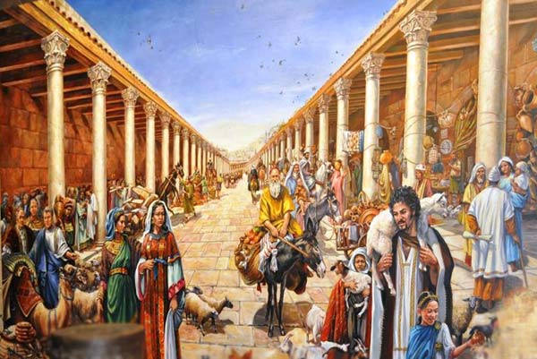
Tithing
Let’s try another passage:
Deuteronomy 14:22-29
It sounds like God is telling them to have a party.
Indeed He is.

Slide 16
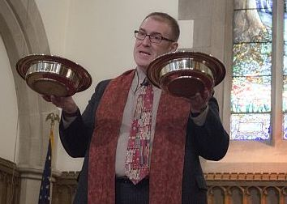
Tithing
But let’s back up for a moment.
God says to take the tithe to Jerusalem. Well, that’s not going to go over well with most pastors. They want money brought
to the offering plate.

Slide 17

Tithing
But let’s back up for a moment.
Next, the tithe isn’t talking about income.
It’s very specific: a tenth of all that is grown from the ground and every tenth animal that was born.
The first born also belonged to the LORD,
but that was not part of the tithe.
(Leviticus 27:26, Numbers 8:17 and 18:15)

Slide 18

Tithing
But let’s back up for a moment.
That’s why Malachi 3:10 talks about a storehouse!

Slide 19


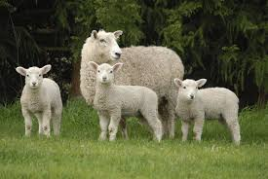
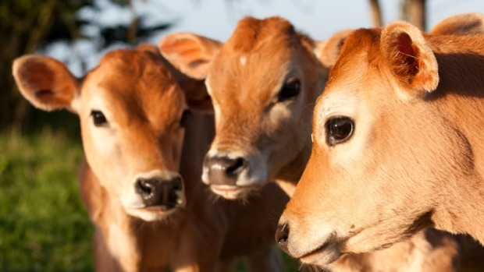
Tithing
But let’s back up for a moment.
So, if you weren’t growing anything in the ground, and you weren’t raising any animals, you were not subject to the tithe!

Slide 20
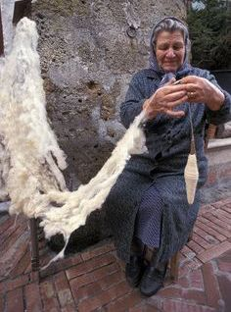
Tithing
But let’s back up for a moment.
For example:
If you bought some wool
from a shepherd, cleaned
it, spun it into yarn, wove it
into cloth, sold the cloth,
and made some money,
you were NOT expected to
give ten per-cent of that
money as a tithe.

Slide 21

Tithing
But let’s back up for a moment.
That was neither the law nor the practice.

Slide 22
Tithing
Only the blessing you got directly from what was produced from the land and every tenth animal you raised was subject to the tithe.
It did not include income at all;
whether it was income from investment,
services rendered, or things sold for profit.

Slide 23

Tithing
Jesus indicates this directly in Matthew 23:23a, if one understands the culture and context of His statement:
“Woe to you, teachers of the law and Pharisees, you hypocrites! You give
a tenth of your spices—mint, dill
and cummin.”

Slide 24
Tithing
The Pharisees gave a tenth of what they grew in their little gardens: spices–mint,
dill, and cumin. They were following the very smallest detail of the Law by giving
a tenth of the miniscule spices that they grew.

Slide 25

Tithing
Many interpret Jesus’ statement to mean the Pharisees were even giving a tenth of the smallest portion of their “income.”
The reality is, the tenth of the mint, dill, and cumin was the entirety of their expected tithe! That’s all they were required to give.
That’s ALL THEY GAVE!

Slide 26
Tithing
The tithe is not a “Value Added Tax.” Additional “tithe” expectations were not added on at each step of “processing” from producer to consumer. If you didn’t grow it from the land or it wasn’t a tenth animal born from your herds, it wasn’t subject to the tithe.

Slide 27

Tithing
How did one give the tithe?
The Israelites were to go to Jerusalem at the appointed time and eat of it in rejoicing with all of Israel.
They were to eat the tithe in the presence of the LORD, sharing it with their children, their servants, and the Levites.

Slide 28
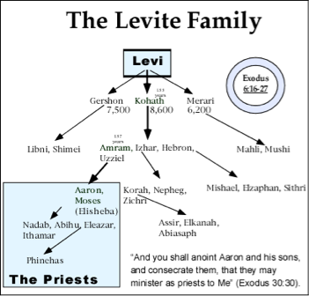
Tithing
How did one give the tithe?
The Levites?
Yes.
When the tithe was brought to Jerusalem,
the Levites came with the people who lived near them and ate of the tithe with them, rejoicing with all Israel.

Slide 29
Tithing
How did one give the tithe?
The Levites?
Yes.
The Levites, the priests, were not allowed to own land, as such. As a “people” they had no inheritance, as the LORD was their inheritance. (Deuteronomy 10:9)

Slide 30

Tithing
How did one give the tithe?
They were given towns to live in and pastureland around the towns.
(Numbers 35:7)
They did not own the land, nor were they supposed to raise crops or animals on the land. Their needs were to be provided by the other tribes. (Deuteronomy 18:1)

Slide 31
Tithing
How did one give the tithe?
If they couldn’t raise animals, why did God give the Levites pasture land?
When the tithe came in, live animals were a large part of it! The live animals were a part of their food supply for the year. They didn’t have freezers back then.

Slide 32
Tithing
How did one give the tithe?
If they couldn’t raise animals, why did God give the Levites pasture land?
The Levites weren’t breeding animals or “raising” them. They were keeping them alive until it was time for them to be eaten.

Slide 33
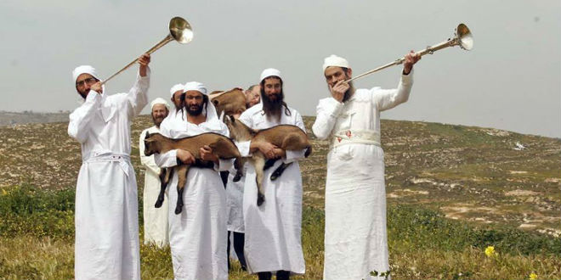
Tithing
Back to the Tithe:
The Israelites were commanded to take the tithe to Jerusalem and have a party with it!
Why would God command this?

Slide 34



Tithing
Back to the Tithe:
God wanted all of Israel to rejoice in His presence over the abundance He provided.

Slide 35
Tithing
Back to the Tithe:
It also brought wealth to His holy city, Jerusalem.
God wanted Jerusalem to be the center of wealth in the region and even the world. By spending and eating in Jerusalem, whenever the tithe was brought in, commerce flourished. The shopkeepers had a heyday!

Slide 36

Tithing
On a regular basis, God’s tithe funneled wealth into Jerusalem. God intended for Jerusalem to be a shining star of His blessing. When foreigners came to Jerusalem they would see the wealth that the Almighty God provided for His people.

Slide 37

Tithing
Whatever was left over was given to the priests at the temple.
Most pastors wouldn’t be too pleased with that.

Slide 38



Tithing
In addition, the amount that was given to the priests at the temple was to cover Law Enforcement, the Court System, Public Welfare Assistance, and other expenses in addition to the support for the priests serving in the worship of God.

Slide 39

Tithing
Every third year, the tithe did not go to Jerusalem, but stayed in the towns and villages where a similar celebration was held locally, sharing with the Levites, aliens, fatherless, and widows—essentially everyone who was around—in order for everyone to acknowledge and be blessed by the LORD.

Slide 40


Tithing
As you can see, this has very little in common with our lives as Christians today.
So, if Christians are not required to tithe, should we simply keep everything to ourselves?
Hah! No. ☺

Slide 41

Tithing
We should look for what the New Testament says on the subject.
Christians were never commanded to tithe.
Christians were never commanded to give.
However, Christians are strongly encouraged to give by laying aside a sum of money,
in proportion to his or her income,
to give to others.

Slide 42
Tithing
Here are some New Testament passages on the subject:
1 Corinthians 16:2 On the first day of every week, each one of you should set aside a sum of money in keeping with his income, saving it up, so that when I come no collections will have to be made.
Acts 11:29 The disciples, each according to his ability, decided to provide help for the brothers living in Judea.

Slide 43
Tithing
Here are some New Testament passages on the subject:
2 Corinthians 8:11 Now finish the work, so that your eager willingness to do it may be matched by your completion of it, according to your means.
2 Corinthians 8:13 Our desire is not that others might be relieved while you are hard pressed, but that there might be equality.
2 Corinthians 8:15 as it is written: "He who gathered much did not have too much, and he who gathered little did not have too little."

Slide 44
Tithing
Christian giving is supposed to be done willingly and cheerfully as one has decided in his heart.

Slide 45


Tithing
Christian giving is supposed to be done willingly and cheerfully as one has decided in his heart.
God doesn’t want you to give if you haven’t resolved the issue in your heart!

Slide 46
Tithing
We are told that if we give generously, we will reap generously, but we are not under compulsion to give.
2 Corinthians 9:6-8 [6] Remember this: Whoever sows sparingly will also reap sparingly, and whoever sows generously will also reap generously. [7] Each man should give what he has decided in his heart to give, not reluctantly or under compulsion, for God loves a cheerful giver. [8] And God is able to make all grace abound to you, so that in all things at all times, having all that you need, you will abound in every good work.

Slide 47
Tithing
We are told that if we give generously, we will reap generously, but we are not under compulsion to give.
2 Corinthians 9:10-11
[10] Now he who supplies seed to the sower and bread for food will also supply and increase your store of seed and will enlarge the harvest of your righteousness. [11] You will be made rich in every way so that you can be generous on every occasion, and through us your generosity will result in thanksgiving to God.

Slide 48
Tithing
Some passages people try to use to enforce tithing are Matthew 23:23 and Matthew 5:20. But we already discussed that the Pharisees were only giving a tenth of their spices. They were relying on their own righteousness; keeping the letter of the law.
As Christians, we don’t rely on our own righteousness to enter the Kingdom of Heaven!

Slide 49

Tithing
Praise God, we rely on the righteousness of our LORD, Jesus Christ!

Slide 50
Tithing
So, the answer is NO! Christians should not tithe—indeed, they cannot! Most of us don’t grow things from the ground or raise animals.
Christians don’t travel to Jerusalem for the feasts multiple times every year.

Slide 51

Tithing
However, Christians should give regularly and be generous with the blessings they have been given from the LORD.

Slide 52
Tithing
Summary
• Tithing was never commanded of Christians
• The Malachi 3:10 promise was never given to Christians
• The Tithe was to come from things produced from the land and every tenth of flocks and herds
• In the New Testament, God never gave a fixed standard for giving
• Christians should always be growing in our love and gratitude
• Some say ten percent is a good place to start
• Ten percent is enough to challenge your faith. It says, “I’m trusting You, God, to meet my needs.” Philippians 4:19 says God will meet all your needs according to His riches in Christ Jesus
• Tithing—even giving—is not a commandment. God wants us to be cheerful givers from the heart.

Slide 53
Tithing
The END

